Slide 1




Project Goal
Credit Card Fraud Detection using 1D CNN
Savitha Namelikonda
Thanishk P
Predict fraudulent credit card transactions to enable early detection and fraud prevention.

Slide 2









Input and Ground Truth
Project Goal
Predict fraudulent credit card transactions to enable early detection and fraud prevention.
Credit Card Fraud Detection using 1D CNN
Savitha Namelikonda
Thanishk P
Model Inputs:
Elapsed time between transactions (in seconds)
28 PCA-transformed features (V1–V28)
Transaction amount
Ground Truth Label: Binary classification (Class)
Class = 1: Fraudulent transaction (Fraud)
Class = 0: Legitimate transaction (Not Fraud)
Relationship: Input features predict whether a transaction is fraudulent or legitimate

Slide 3
Dataset Description
Input and Ground Truth
Project Goal
Model Inputs:
Elapsed time between transactions (in seconds)
28 PCA-transformed features (V1–V28)
Transaction amount
Ground Truth Label: Binary classification (Class)
Class = 1: Fraudulent transaction (Fraud)
Class = 0: Legitimate transaction (Not Fraud)
Relationship: Input features predict whether a transaction is fraudulent or legitimate
Predict fraudulent credit card transactions to enable early detection and fraud prevention.
Dataset: Credit Card Fraud Detection (Kaggle)
Size: 284,807 records
Classes:
Fraud: 492 transactions
Non-fraud: 284,315 transactions (highly imbalanced)
Format: CSV file (comma-delimited)
Availability: Public dataset; original features not disclosed for confidentiality

Slide 4
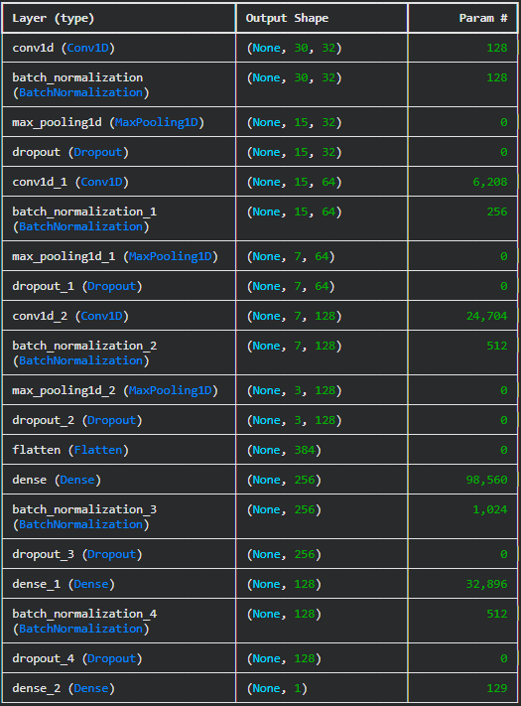
1D CNN
Model Architecture
(Thanishk)
Dataset Description
Input and Ground Truth
Dataset: Credit Card Fraud Detection (Kaggle)
Size: 284,807 records
Classes:
Fraud: 492 transactions
Non-fraud: 284,315 transactions (highly imbalanced)
Format: CSV file (comma-delimited)
Availability: Public dataset; original features not disclosed for confidentiality
Model Inputs:
Elapsed time between transactions (in seconds)
28 PCA-transformed features (V1–V28)
Transaction amount
Ground Truth Label: Binary classification (Class)
Class = 1: Fraudulent transaction (Fraud)
Class = 0: Legitimate transaction (Not Fraud)
Relationship: Input features predict whether a transaction is fraudulent or legitimate

Slide 5
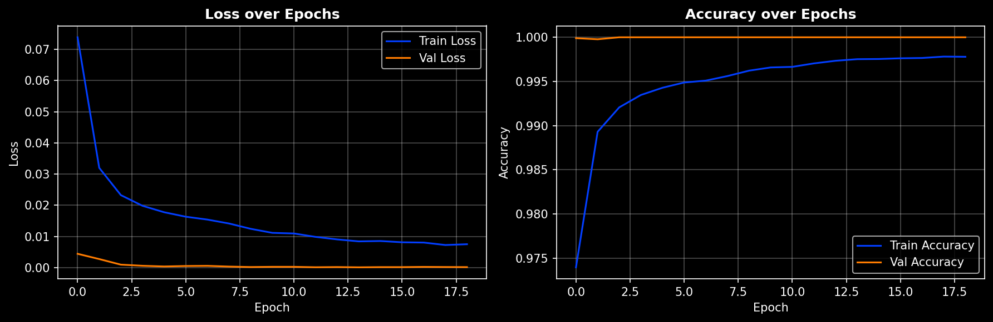
Training Details
1D CNN
Model Architecture
(Thanishk)
Dataset Description
Dataset: Credit Card Fraud Detection (Kaggle)
Size: 284,807 records
Classes:
Fraud: 492 transactions
Non-fraud: 284,315 transactions (highly imbalanced)
Format: CSV file (comma-delimited)
Availability: Public dataset; original features not disclosed for confidentiality
Optimizer: Adam
Learning Rate: 0.001
Batch Size: 32
Epochs: 50
Seed: 42
Trained on TensorFlow 2.20 (CPU)

Slide 6
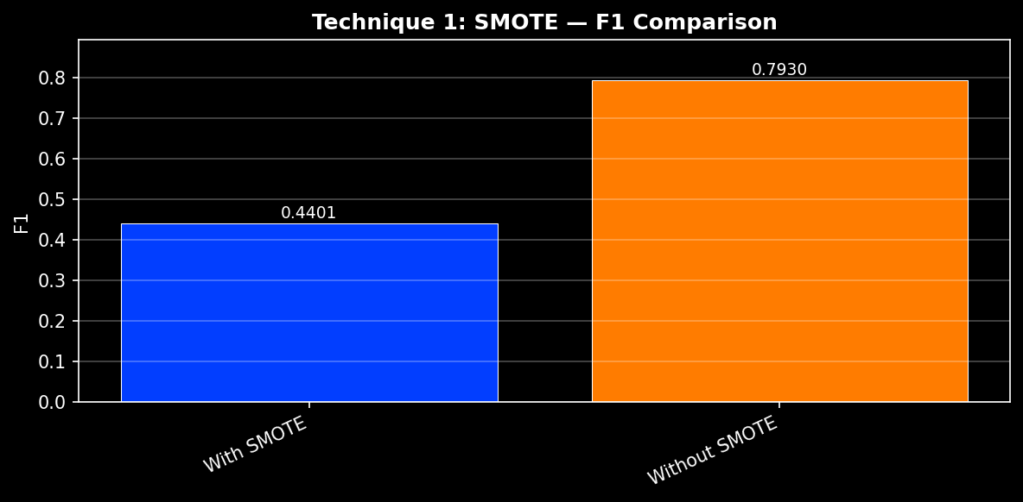
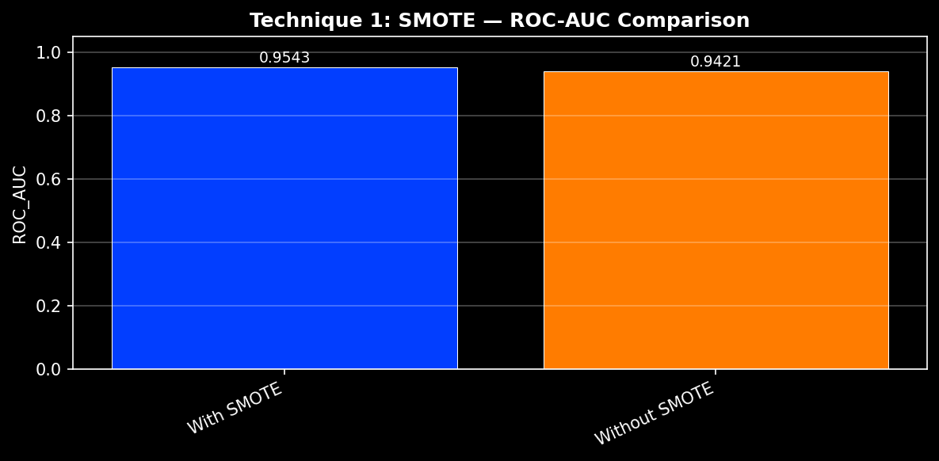
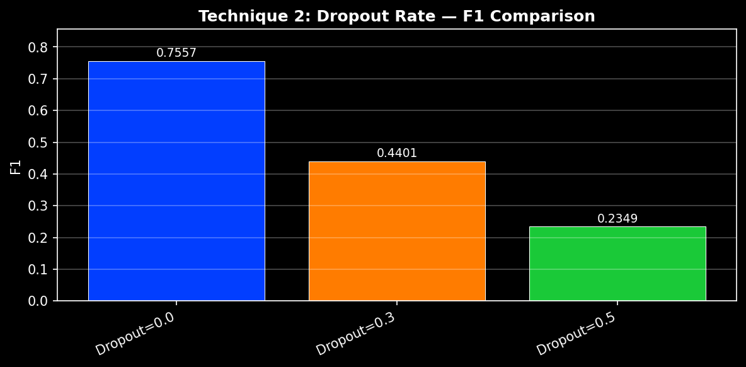
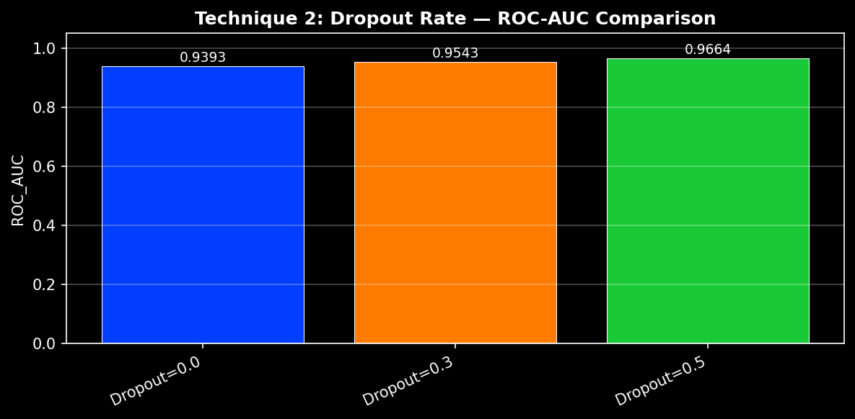
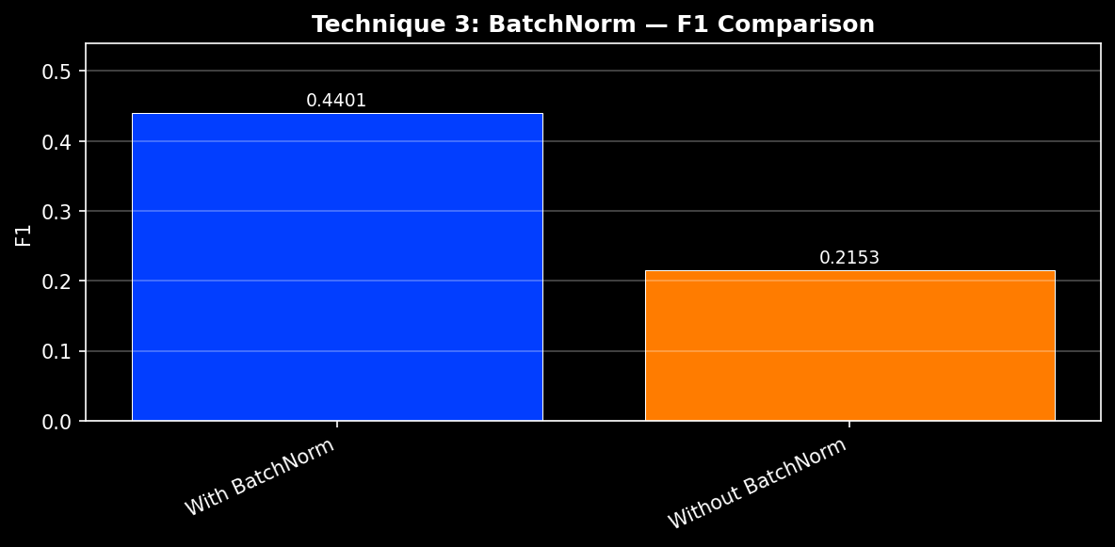
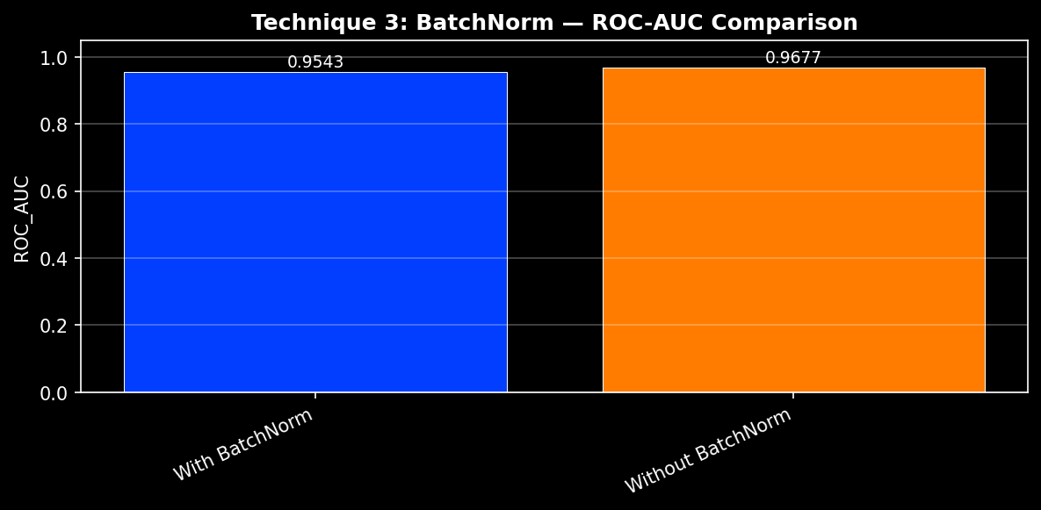
Ablation Study
Training Details
1D CNN
Model Architecture
(Thanishk)
Optimizer: Adam
Learning Rate: 0.001
Batch Size: 32
Epochs: 50
Seed: 42
Trained on TensorFlow 2.20 (CPU)
Smote
Drop out
Batch Normalization

Slide 7
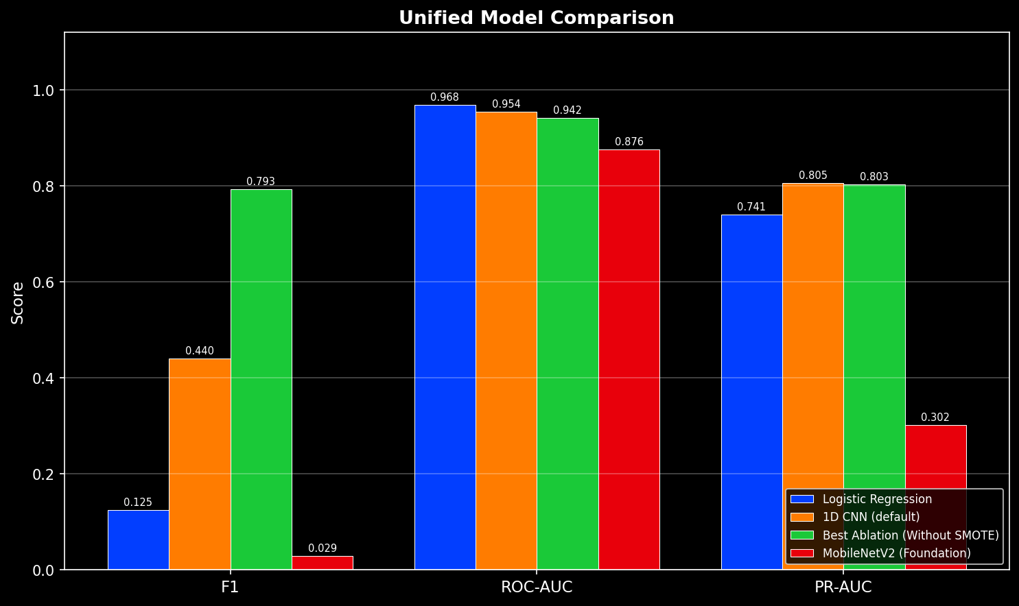
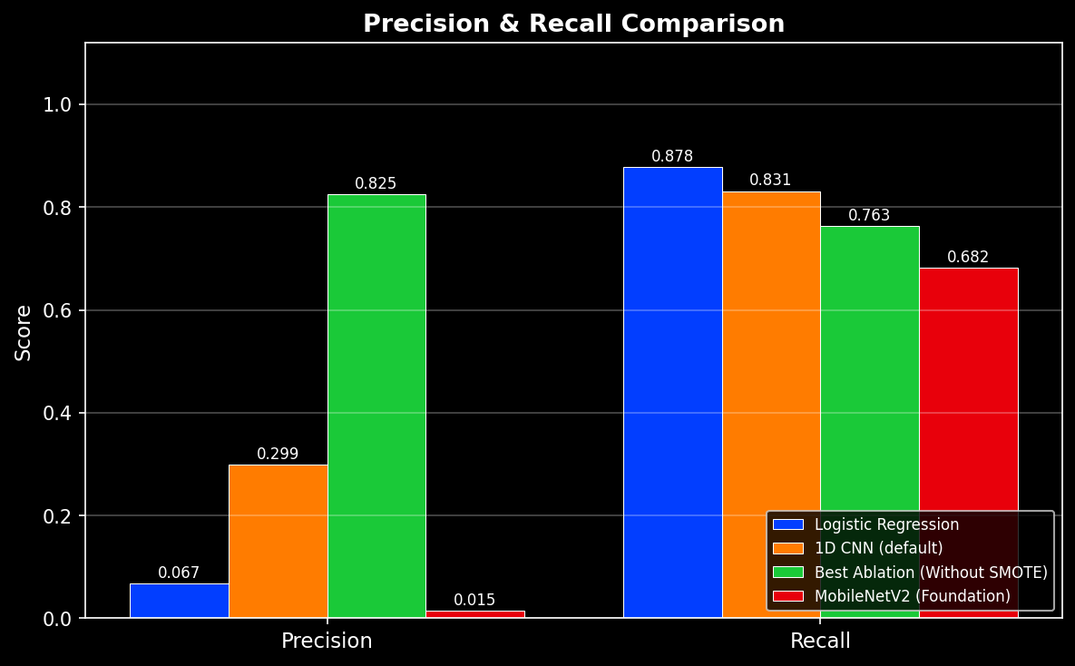
Foundation Model
Comparison
Ablation Study
Training Details
Smote
Drop out
Batch Normalization
Optimizer: Adam
Learning Rate: 0.001
Batch Size: 32
Epochs: 50
Seed: 42
Trained on TensorFlow 2.20 (CPU)

Slide 8
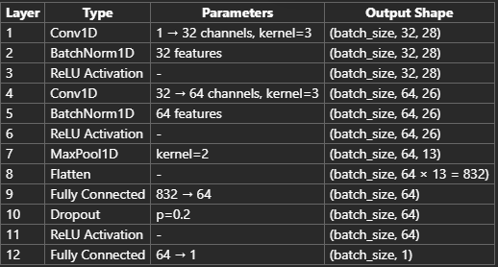
1D CNN
Model Architecture
(Savitha)
Foundation Model
Comparison
Ablation Study
Smote
Drop out
Batch Normalization

Slide 9
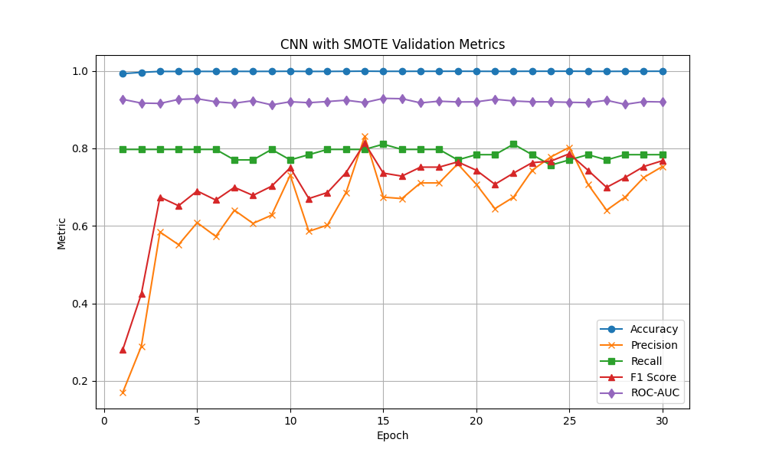
Foundation Model
Comparison
Training Details
1D CNN
Model Architecture
(Savitha)
Optimizer: Adam
Learning Rate: 0.01
Batch Size: 256
Epochs: 30
Seed: 123
Trained on PyTorch

Slide 10
Technique Study
Training Details
1D CNN
Model Architecture
(Savitha)
Optimizer: Adam
Learning Rate: 0.01
Batch Size: 256
Epochs: 30
Seed: 123
Trained on PyTorch
Model | Accuracy | Precision | Recall | F1_Score | ROC_AUC | Training_Loss_Final | SMOTE
CNN base model with learning_rate=0.01 and epochs=30 | 0.9988765 | 0.6444444 | 0.7837838 | 0.70731707 | 0.9402946 | 0.0032 | Applied
CNN model with learning_rate=0.001 and epochs=30 | 0.9992978 | 0.8055556 | 0.7837838 | 0.79452055 | 0.9627718 | 0.001 | Applied
CNN model with learning_rate=0.01 and epochs=15 | 0.9988998642385656 | 0.6483516483516484 | 0.7972972972972973 | 0.7151515151515152 | 0.9479209442982657 | 0.00461811 | Applied
CNN model with learning_rate=0.01 and epochs=30 | 0.9947567997752914 | 0.22627737226277372 | 0.8378378378378378 | 0.3563218390804598 | 0.9612688976258196 | 0.7469 | Not Applied
Smote
Learning Rate
Epochs

Slide 11
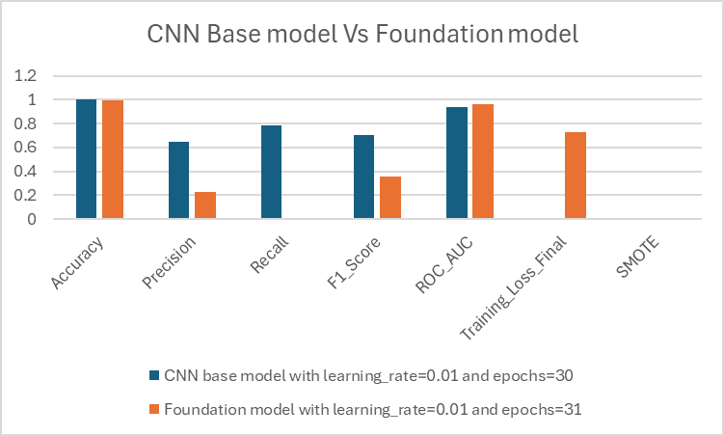
Foundation Model
Comparison
Technique Study
Training Details
Model | Accuracy | Precision | Recall | F1_Score | ROC_AUC | Training_Loss_Final | SMOTE
CNN base model with learning_rate=0.01 and epochs=30 | 0.9988765 | 0.6444444 | 0.7837838 | 0.70731707 | 0.9402946 | 0.0032 | Applied
CNN model with learning_rate=0.001 and epochs=30 | 0.9992978 | 0.8055556 | 0.7837838 | 0.79452055 | 0.9627718 | 0.001 | Applied
CNN model with learning_rate=0.01 and epochs=15 | 0.9988998642385656 | 0.6483516483516484 | 0.7972972972972973 | 0.7151515151515152 | 0.9479209442982657 | 0.00461811 | Applied
CNN model with learning_rate=0.01 and epochs=30 | 0.9947567997752914 | 0.22627737226277372 | 0.8378378378378378 | 0.3563218390804598 | 0.9612688976258196 | 0.7469 | Not Applied
Optimizer: Adam
Learning Rate: 0.01
Batch Size: 256
Epochs: 30
Seed: 123
Trained on PyTorch
Smote
Learning Rate
Epochs
Model | Accuracy | Precision | Recall | F1_Score | ROC_AUC | Training_Loss_Final | SMOTE
CNN base model with learning_rate=0.01 and epochs=30 | 0.998876 | 0.644444 | 0.783784 | 0.707317 | 0.940295 | 0.0032 | Applied
Foundation model with learning_rate=0.01 and epochs=30 | 0.994687 | 0.223827 | 0.8378378378378378 | 0.353276 | 0.964894 | 0.729727 | Applied

Slide 12
Foundation Model
Comparison
Technique Study
Model | Accuracy | Precision | Recall | F1_Score | ROC_AUC | Training_Loss_Final | SMOTE
CNN base model with learning_rate=0.01 and epochs=30 | 0.9988765 | 0.6444444 | 0.7837838 | 0.70731707 | 0.9402946 | 0.0032 | Applied
CNN model with learning_rate=0.001 and epochs=30 | 0.9992978 | 0.8055556 | 0.7837838 | 0.79452055 | 0.9627718 | 0.001 | Applied
CNN model with learning_rate=0.01 and epochs=15 | 0.9988998642385656 | 0.6483516483516484 | 0.7972972972972973 | 0.7151515151515152 | 0.9479209442982657 | 0.00461811 | Applied
CNN model with learning_rate=0.01 and epochs=30 | 0.9947567997752914 | 0.22627737226277372 | 0.8378378378378378 | 0.3563218390804598 | 0.9612688976258196 | 0.7469 | Not Applied
Model | Accuracy | Precision | Recall | F1_Score | ROC_AUC | Training_Loss_Final | SMOTE
CNN base model with learning_rate=0.01 and epochs=30 | 0.998876 | 0.644444 | 0.783784 | 0.707317 | 0.940295 | 0.0032 | Applied
Foundation model with learning_rate=0.01 and epochs=30 | 0.994687 | 0.223827 | 0.8378378378378378 | 0.353276 | 0.964894 | 0.729727 | Applied
Smote
Learning Rate
Epochs
Thank You

Slide 13
Foundation Model
Comparison
Model | Accuracy | Precision | Recall | F1_Score | ROC_AUC | Training_Loss_Final | SMOTE
CNN base model with learning_rate=0.01 and epochs=30 | 0.998876 | 0.644444 | 0.783784 | 0.707317 | 0.940295 | 0.0032 | Applied
Foundation model with learning_rate=0.01 and epochs=30 | 0.994687 | 0.223827 | 0.8378378378378378 | 0.353276 | 0.964894 | 0.729727 | Applied
Thank You

